Slide 1


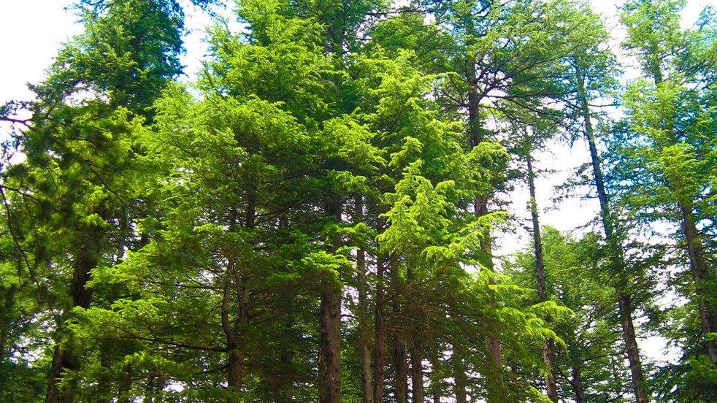

McLane PTSO Trail and Garden Committee
A Proposal that supports the McLane Students, Families and the West Olympia Community
---------------------------------------------------------------------------------------------------
When was the last time you tree bathed in the verdant beauty of the
McLane Trail?
Everyday, members of the West Olympia community enjoy the natural
beauty of the McLane Trail and surrounding area
For years, this area has served as an outdoor classroom for McLane
Students
During the last 8 months this area has aided the West Olympia
Community in ways we can’t imagine
This Photo by Unknown Author is licensed under CC BY-SA-NC
Notes:
When was the last time you tree bathed in the verdant beauty of the McLane Trail?
Everyday, members of the West Olympia community enjoy the natural beauty of the McLane Trail and surrounding area
For years, this area has served as an outdoor classroom for McLane Students
During the last 8 months this area has aided the West Olympia Community in ways we can’t imagine

Slide 2

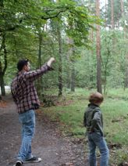
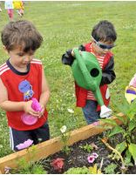

McLane Trail and Garden Committee
The McLane Trail and Garden Committee was formally established in October 2020 through a growing interest by Teachers, Students, Families, and Community Members proactively seeking to develop more interactive green space for the Community
Revitalize trail maintenance and planting
Create educational opportunities tied to the natural space of our neighborhood (Virtually Guided Tours, Educational Signs, and Seasonal Events)
Develop cultural recognition of our Native American heritage
Develop Community Gardens, Trails, Barefoot space, cultivate native flora and fauna, and natural classroom space
This Photo by Unknown Author is licensed under CC BY-SA
This Photo by Unknown Author is licensed under CC BY-NC-ND
This Photo by Unknown Author is licensed under CC BY-SA

Slide 3
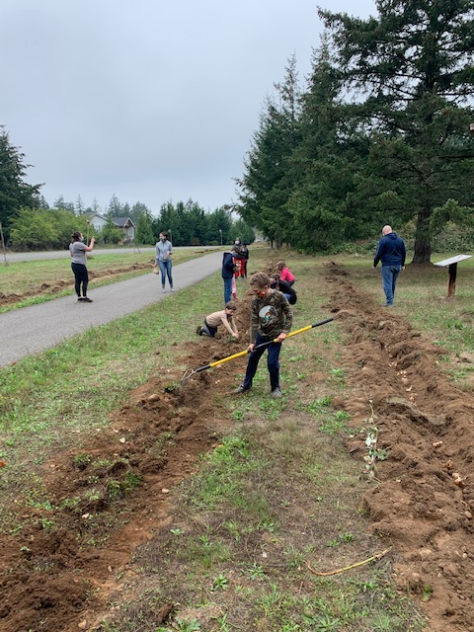
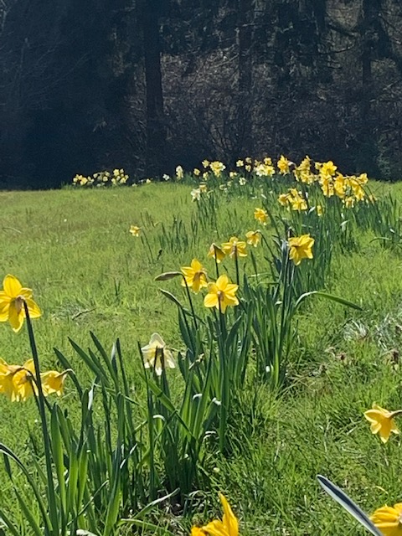
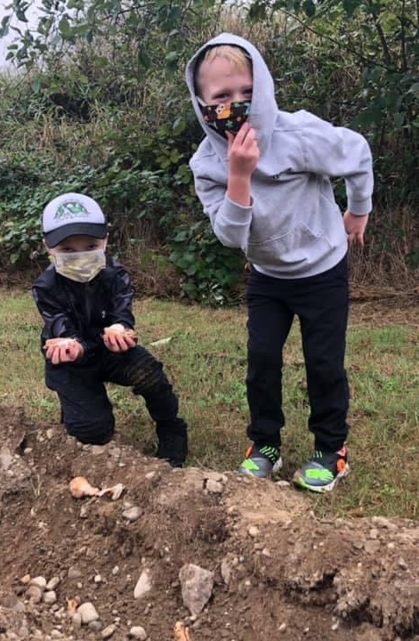
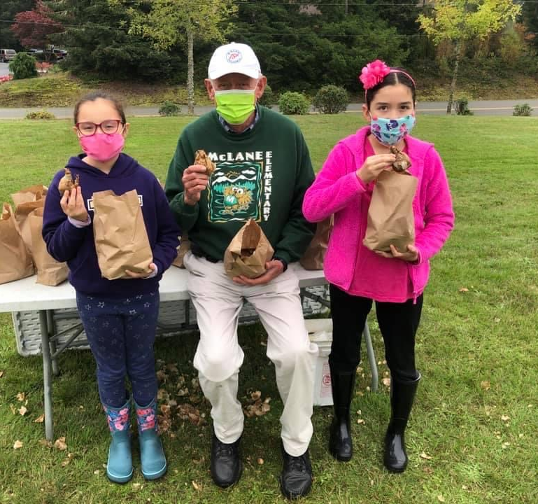
The Need
OSD student outcome three: Students will advocate for their own physical and mental wellness and be hopeful about their future
Two seasonal events for Rotarian volunteers (more available throughout the year)
Creates an equal opportunity that is accessible to all Students for them to explore and learn about their environment
Builds a Community space geared to exercise, psychological restoration, and safe space for socializing
This project will replace, restore and maintain the current trail, renew signs, create above ground gardens, as well as other community centered initiatives

Slide 4
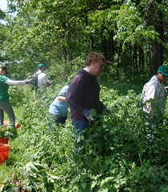

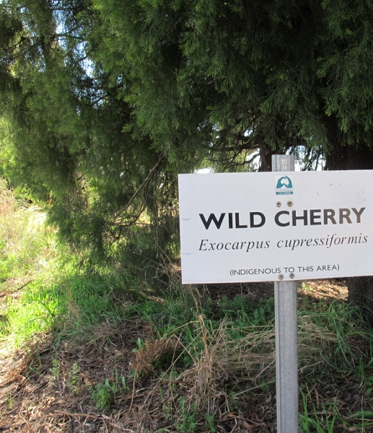

The Project
Revitalize Signs and Restore Trail
Modernize upkeep
Mark distances on the trail
Plan Spring planting event (Earth Day)
Trail Maintenance with additional plants
Clear undergrowth
Provide more Trash Receptacles
Restore teaching platforms and fences for safety
This Photo by Unknown Author is licensed under CC BY
This Photo by Unknown Author is licensed under CC BY-SA
This Photo by Unknown Author is licensed under CC BY
This Photo by Unknown Author is licensed under CC BY-SA-NC

Slide 5
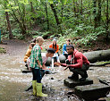
McLane Community Connections….
This project will support not only McLane Elementary school but the West Olympia community at large
This project will invite community partners for continuing growth and development
  AmeriCorps
  Local College Ecology, Gardening and Forestry Programs
  State/County Parks
  CISPUS
  Rotary Club
  Local Business
  Engage ALL Community Members equally
Notes:
Nearly 1/3 of our students qualify for Free and reduce meals
20% of our students qualify for special education services including a phenomenal life-skills program that serves the district most impacted students

Slide 6
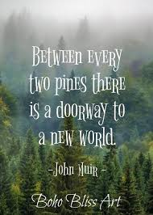
Outcomes
Through this project: Students will advocate for their own physical and mental wellness and be hopeful about their future (OSD Student outcome three)
Develop and Build a community space for West Olympia and the McLane Community advocating conservation, exercise and the environment
Improve the physical and mental wellness of the West Olympia community
During a time when everything is focused on Internet, Computers and Distancing, this allows members of our community to invest in a safe and “hands on” manner
Accessible to all
Collaboration with the Rotary will highlight Rotary activities in the community

Slide 7

Partnering with Westside Story
We are grateful for your consideration in supporting the McLane and Westside Community. We are fully committed to showcasing our project at the February event and supporting the Westside Rotary Club though out the entire year. I hope that this can be the start of a remarkable partnership.

